Slide 1
Basic concepts
Introduction to computational thinking

Slide 2
What is computational thinking?

Slide 3
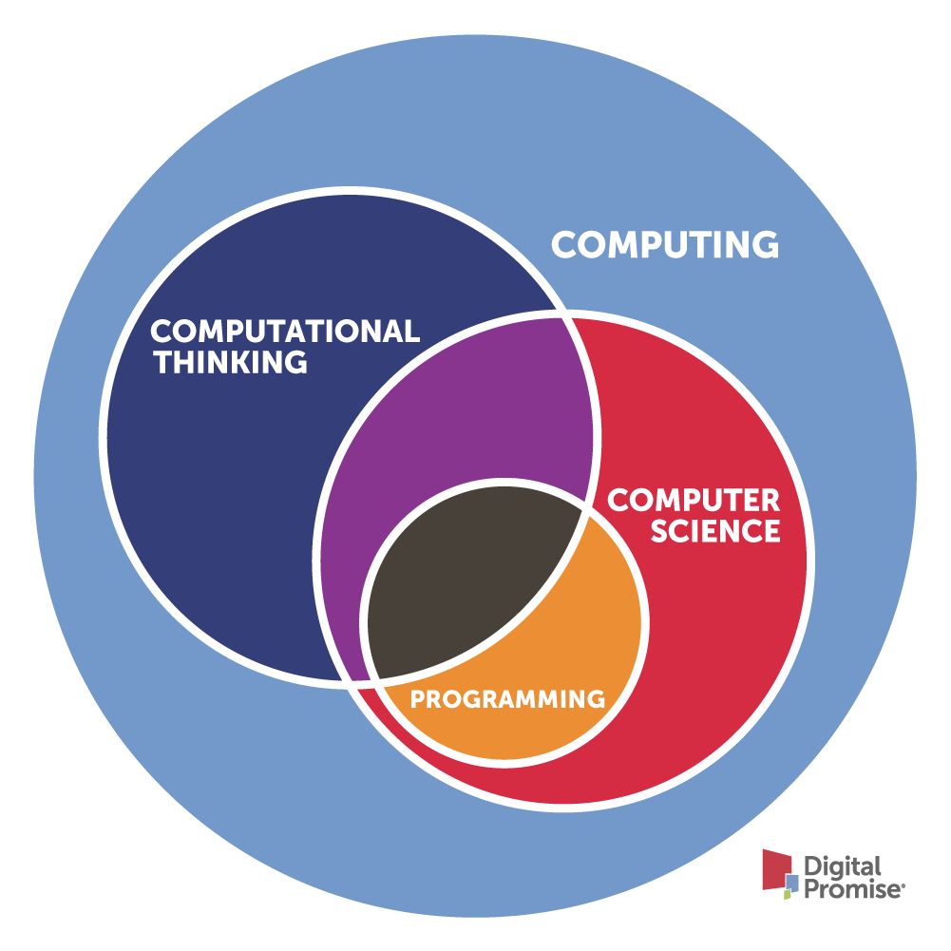
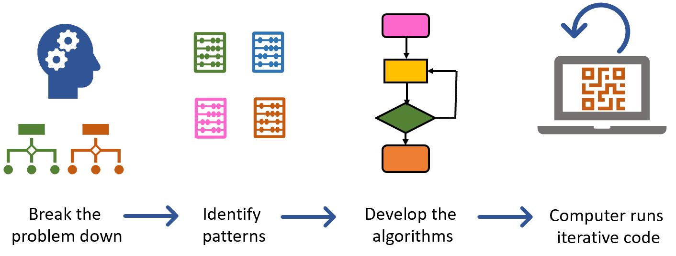
Problem-solving process
Steps to find solutions using methods of computer science

Slide 4
Activity - Slido
What is computer science?

Slide 5
Overview of computer science

Slide 6
A. Theoretical Foundations
Algorithms & Data Structures
Computability & Complexity Theory
Discrete Mathematics
Automata Theory & Formal Languages

Slide 7
B. Software Systems
Programming Languages
Software Engineering
Operating Systems
Compilers

Slide 8
C. Computer Systems & Networking
Computer Architecture
Embedded Systems
Computer Networks
Distributed Systems

Slide 9
D. AI & Data Science
Machine Learning / Deep Learning
Natural Language Processing (NLP)
Computer Vision
Reinforcement Learning
Data Mining & Big Data
Statistics & Probability for AI

Slide 10
E. Applied Computing
Human–Computer Interaction (HCI)
Graphics & Visualization
Game Development
Cybersecurity & Cryptography
Bioinformatics / Computational Biology
Robotics & Autonomous Systems

Slide 11
F. Social & Ethical Dimensions
Ethics in AI
Computer Security Policy & Governance
Computational Social Science

Slide 12
G. Emerging Areas
Quantum Computing
Augmented & Virtual Reality (AR/VR)
Edge Computing / Federated Learning
Large Language Models & Multimodal AI
Explainable AI (XAI)

Slide 13
Pillars of Computational thinking

Slide 14
Basic steps
Decomposition: Breaking down complex problems into manageable parts
Pattern Recognition: Spotting similarities, trends, or repeated structures
Abstraction: Removing irrelevant details to focus on what matters
Algorithm Design: Create step-by-step instructions to solve the problem

Slide 15
Extended steps in practice
Problem Analysis (from ill-defined to well-defined)
Decomposition
Pattern Recognition & Abstraction
Algorithm Design
Representation
Implementation / Simulation
Evaluation & Reflection

Slide 16
Example
Fake news detection

Slide 17
1. Problem Analysis
Understand what “fake news” means and what makes it distinct from real news.
Identify the goals (e.g., classify articles as real/fake).
Define inputs (article text, author, date, source, image, etc.) and outputs (label: fake or real).
Consider challenges, such as sarcasm, political bias, and misinformation spread.

Slide 18
2. Decomposition
Break the problem into smaller, manageable subproblems:
Collect and preprocess text data.
Extract linguistic and semantic features.
Identify misinformation patterns (e.g., emotional language, unreliable sources).
Train and evaluate a classification model.
Each subproblem can be solved independently and then integrated into a full pipeline

Slide 19
3. Pattern Recognition
Detect recurring features that differentiate fake from real:
Fake news tends to use hyperbolic or emotional language.
Real news tends to have structured reporting and trusted sources.
Certain words or patterns (e.g., “shocking,” “you won’t believe”) occur more often in fake news.
Recognizing these patterns helps build better features for detection.

Slide 20
4. Abstraction
Focus on essential information while ignoring irrelevant details:
Represent news articles as vectors (e.g., TF-IDF, word embeddings).
Abstract away from the literal text to higher-level concepts (topics, sentiment, credibility).
This allows computational models to process complex content efficiently.

Slide 21
5. Algorithm Design
Design a process (or pipeline) to detect fake news:
Input: raw article text
Preprocessing: tokenization, stopword removal
Feature extraction: text embeddings, source credibility scores
Classification: logistic regression, SVM, BERT, etc.
Output: fake/real label
This algorithm can be expressed as pseudocode or flowcharts.

Slide 22
6. Implementation / Simulation
Write and test code to implement the fake news detector:
Use Python libraries (scikit-learn, transformers).
Simulate the model on real datasets like FakeNewsNet or LIAR.
Evaluate using accuracy, precision, recall, and F1 score.

Slide 23
7. Evaluation & Reflection
Assess how well the solution works:
Does it generalize to unseen news?
What biases exist in the dataset?
How can it be improved (e.g., adding multimodal data: images, user behavior)?
Encourage reflection on ethical aspects — e.g., fairness, misinformation harm.

Slide 24
Activity

Slide 25
Escape room challenge
Create 3 puzzles to create a passcode with 3 numbers to unlock the lock.

Slide 26
Homework

Slide 27
Group 1-2 members
Write a program in C++/Python that asks 3 questions, each question & answer will hint at a number from 0-9
Together these three numbers will create a final combination to unlock the email to contact the author for collaboration offer.
Focus on code quality!

